Slide 1
High Cloud Data Analysis
Project Member Name
Naavya Kumar
Gayathri Dantu
Sakshi Shivraj Patil
K. Ruth Celestial
Sonika Hampapura Raju
Ahmed Nuh Khalif
E.vamsi

Slide 2
Index
KPI Analysis
Insights
Dashboards (Tableau, Power BI, Excel, MySQL)
Conclusion & Recommendation
Challenges Faced

Slide 3
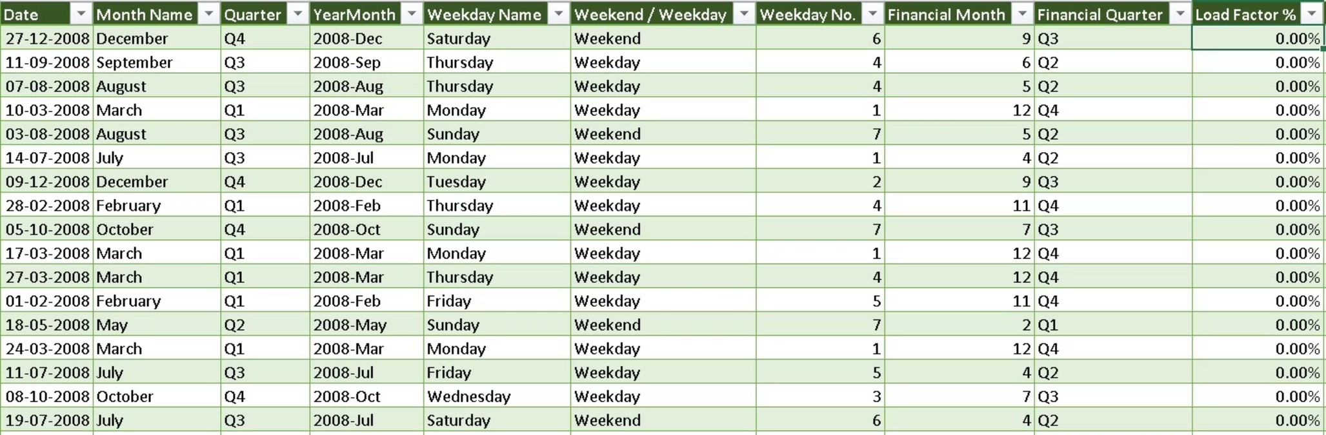
KPI
To make time based analysis easier:

Slide 4
Load Factor Trend (Year-wise)
Row Labels
Sum of Load Factor %
2008
15.83%
2009
15.66%
2010
16.82%
2011
17.42%
2012
16.87%
2013
17.40%
Grand Total
100.00%

Slide 5
Year-wise Load Factor Analysis
Load factor shows a gradual increase over the years
Indicates improved performance and better utilization
Strong growth observed from 2008 to 2011
Peak performance in 2011 (17.42%)
Slight decline in 2012
Recovered again in 2013, showing stability
Overall trend is steady with minor fluctuations

Slide 6
Load Factor Trend (Month-wise)
Row Labels
Sum of Load Factor %
January
7.61%
February
7.57%
March
8.23%
April
8.29%
May
8.34%
June
9.05%
July
9.06%
August
9.01%
September
8.24%
October
8.18%
November
8.22%
December
8.20%
Grand Total
100.00%

Slide 7
Monthly Load Factor Analysis
Lowest load factor in January & February (off-season)
Gradual increase from March to May
Peak period during June, July, and August
Indicates highest demand and maximum utilization
Decline starts after August
Stable performance from September to December
Shows a clear seasonal trend
Useful for planning pricing, scheduling, and capacity

Slide 8
Load Factor (Quarter-wise)
Row Labels
Sum of Load Factor %
Q1
23.41%
Q2
25.68%
Q3
26.31%
Q4
24.60%
Grand Total
100.00%

Slide 9
Quarter-wise Load Factor Analysis
Q1 has the lowest performance (slow start of the year)
Steady growth observed from Q1 to Q3
Q3 is the highest-performing quarter
Indicates mid-year peak business period
Slight decline in Q4 after peak season
Q4 still performs better than Q1
Shows a cyclical/seasonal trend
Useful for resource allocation and planning

Slide 10
Carrier-wise Load Factor
Carrier-wise Load Factor Performance
Row Labels
Sum of Load Factor %
Continental Air Lines Inc.
16.30%
Delta Air Lines Inc.
27.87%
Skywest Airlines Inc.
13.80%
Southwest Airlines Co.
26.90%
Us Airways Inc.
15.13%
Grand Total
100.00%

Slide 11
Carrier-wise Load Factor Analysis
Delta Airlines has the highest load factor
Indicates strong demand and high efficiency
Southwest Airlines is a close competitor
Continental & US Airways show average performance
SkyWest Airlines has the lowest load factor
Clear gap between top and bottom performers
Differences may be due to routes, pricing, or service quality
Top carriers can be used as benchmarks for improvement

Slide 12
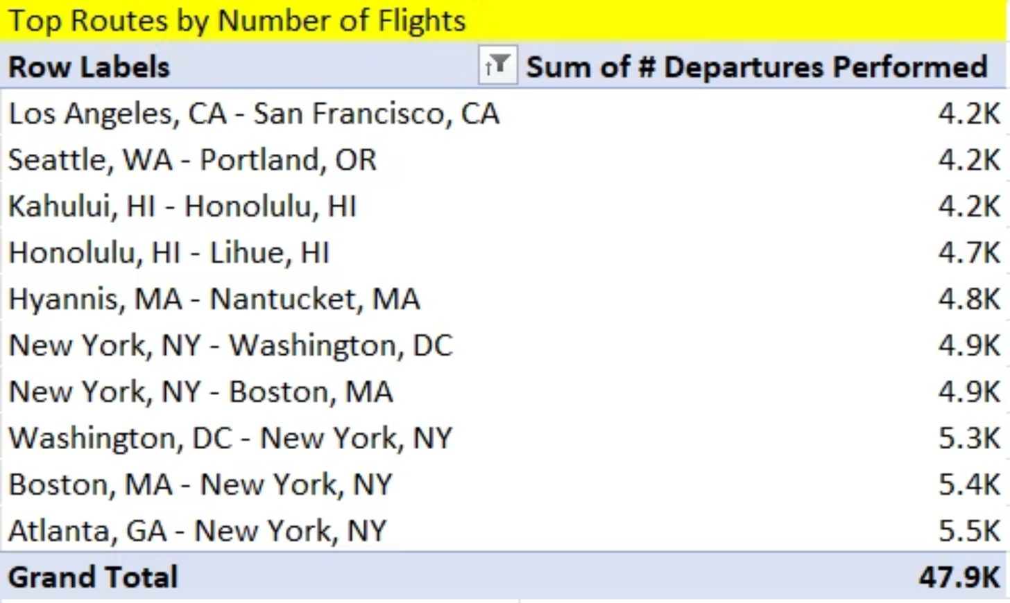
Top Routes by Flights

Slide 13
Top Routes by Flights
New York acts as a major hub
Atlanta–New York is the most frequent route
Strong connectivity with Boston and Washington routes
High traffic in both directions (two-way demand)
Regional routes (Hawaii inter-island) show steady demand
Busy short routes like LA–San Francisco and Seattle–Portland
Most routes are short to medium distance
Network focuses on high-demand and hub-based connectivity

Slide 14
Weekend vs Weekday Analysis
Load Factor : Weekend vs Weekday
Row Labels
Sum of Load Factor %
Weekday
71.17%
Weekend
28.83%
Grand Total
100.00%

Slide 15
Weekend vs Weekday Analysis
Weekdays contribute 71.17% of total flights
Weekends contribute only 28.83%
Indicates strong dependence on weekdays
Majority passengers are business travelers or commuters
Significant gap between weekday and weekend demand
Airlines can improve weekend demand through offers
Operations aligned with business schedules
Overall shows strong weekday dominance

Slide 16
Flights by Distance Group
Flights Distribution by Distance Group
Count of %Distance Group ID
0-500
58199
1001-1500
11335
1500+
13334
501-1000
27980
Grand Total
110848

Slide 17
Flights by Distance Group
Majority of flights are in 0–500 km range
Indicates high demand for short-distance travel
501–1000 km range also shows strong activity
1000–1500 km has the lowest number of flights
Long-distance (1500+ km) flights are less frequent
Focus is mainly on short-haul operations
Opportunity to expand long-distance routes
Overall shows a volume-driven short-distance strategy

Slide 18
FINAL OVERALL INSIGHT
The data shows steady growth and stable performance over time.
There is a clear seasonal and quarterly pattern, with mid-year peak.
Weekdays and short-distance routes dominate, indicating business-driven demand.
A few airlines and routes contribute majorly to performance, showing concentration.
The insights can help in better planning, optimization, and decision-making.

Slide 19
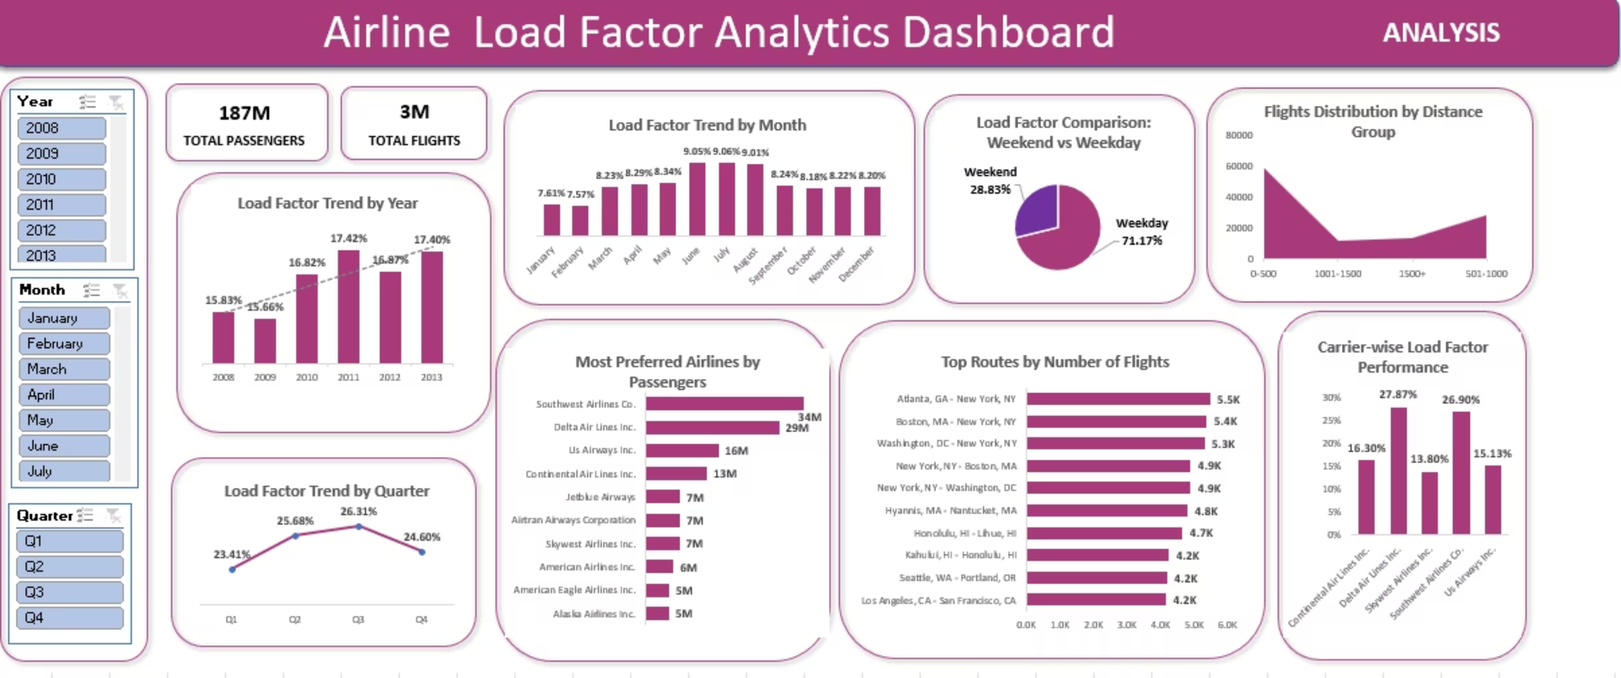
DASHBOARDS
EXCEL DASHBOARD

Slide 20
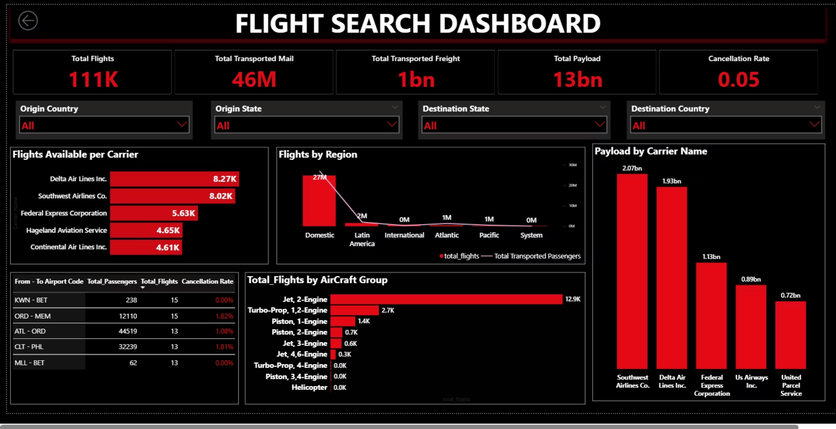
POWER BI DASHBOARD

Slide 21
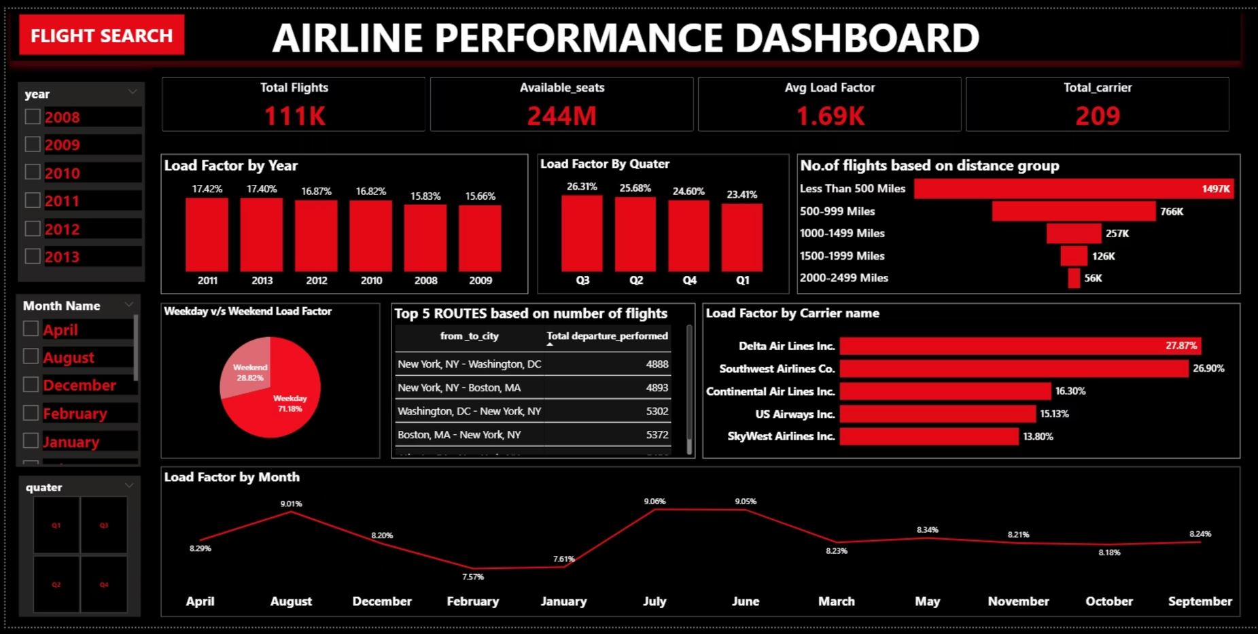

Slide 22
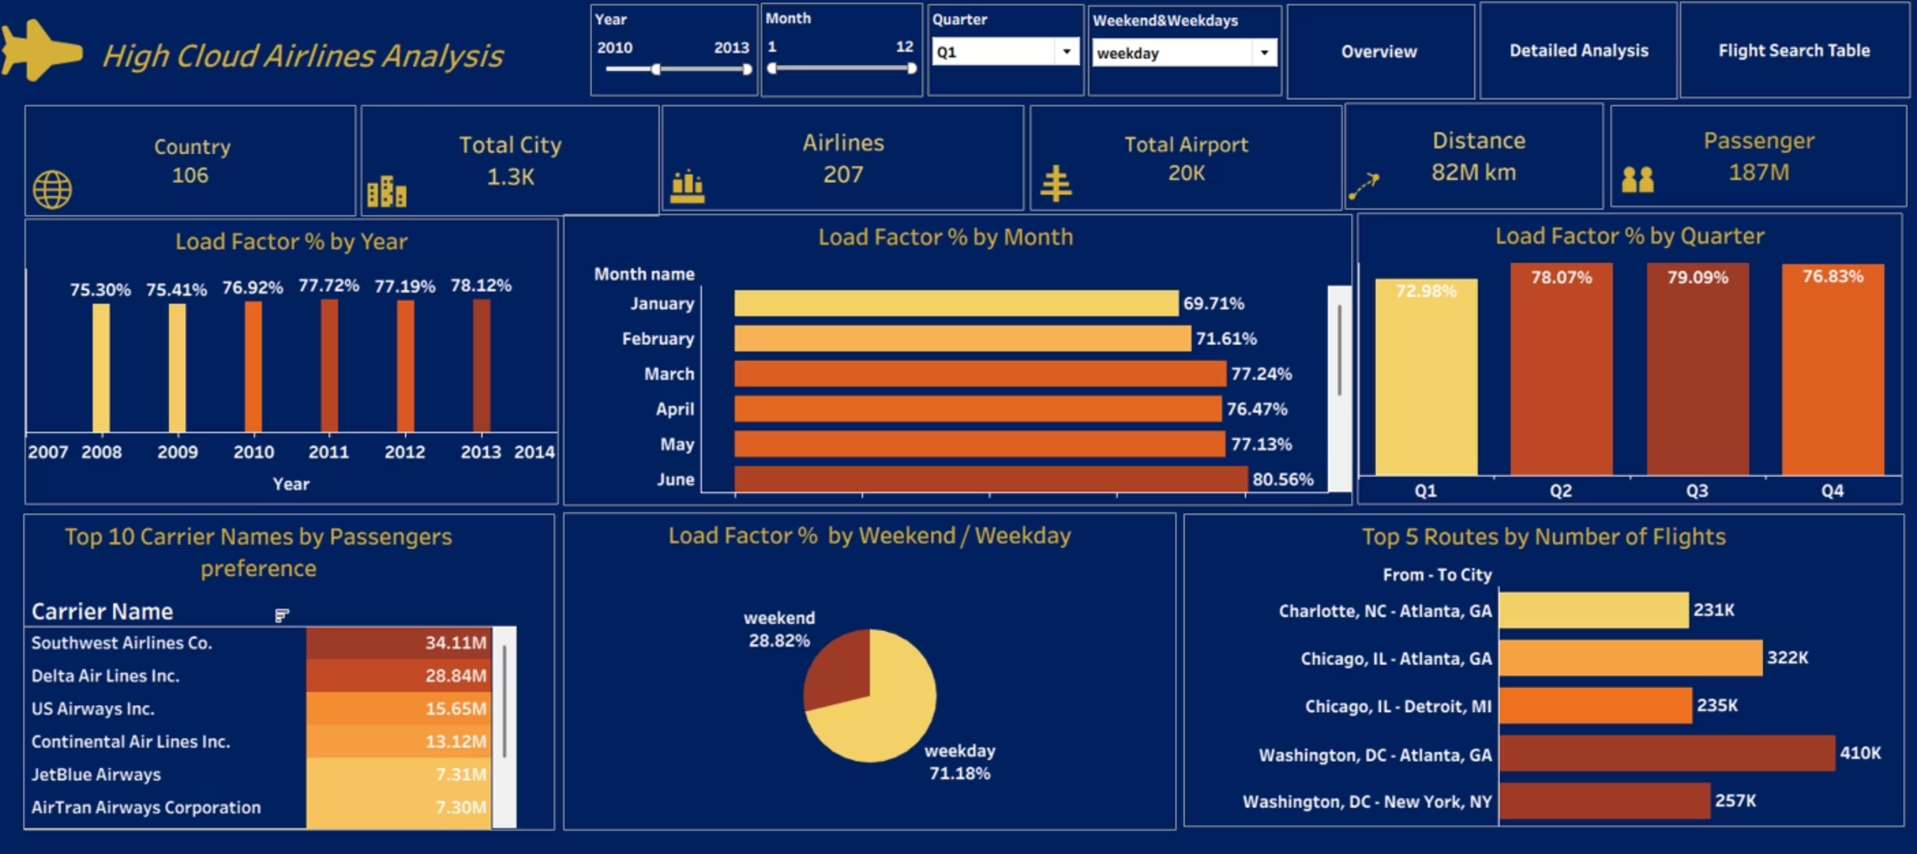
TABLEAU DASHBOARD

Slide 23
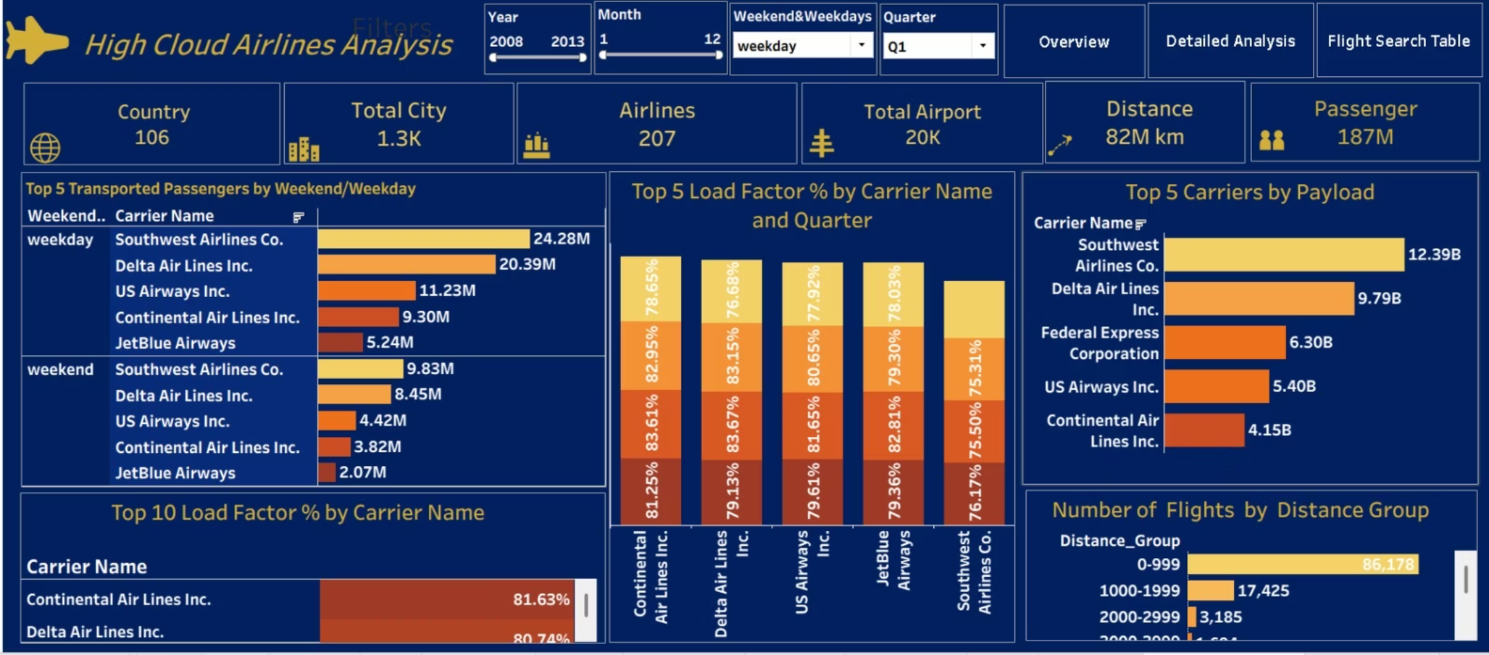

Slide 24
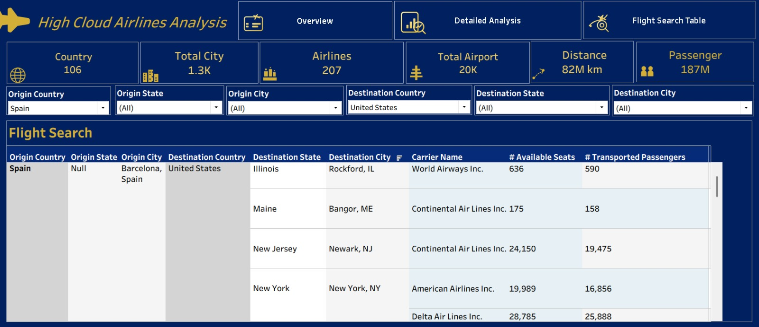

Slide 25
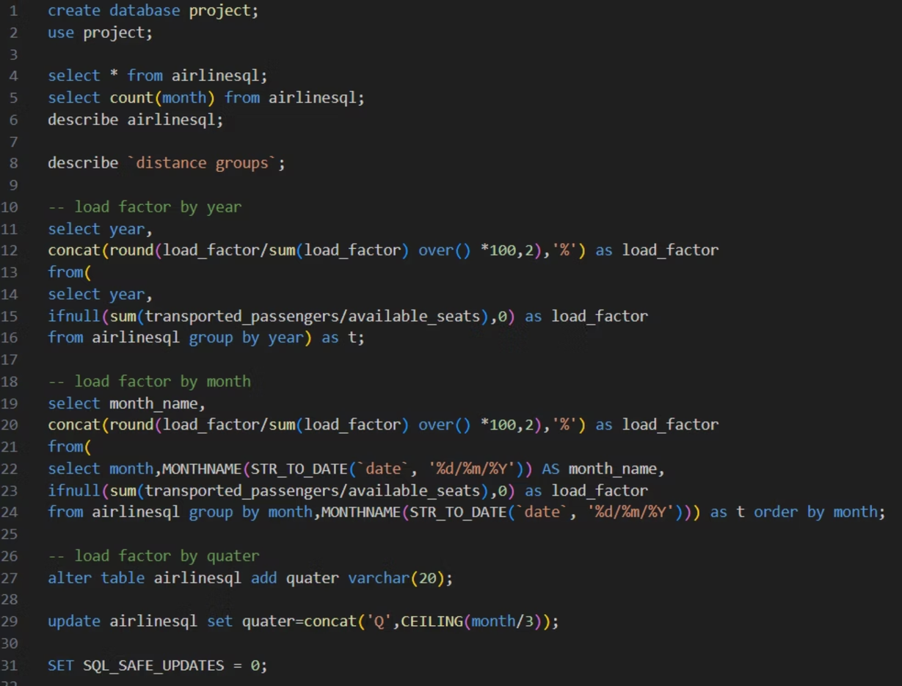
MySQL QUERIES

Slide 26
32 select quater,
33 concat(round(load_factor/sum(load_factor) over() *100,2),'%') as load_factor
34 from(
35 select quater,
36 ifnull(sum(transported_passengers/available_seats),0) as load_factor
37 from airlinesql group by quater) as t;
39 -- loadfactor by weekname
40 select weekname,
41 concat(round(load_factor/sum(load_factor) over() *100,2),'%') as load_factor
42 from(
43 select weekname,
44 ifnull(sum(transported_passengers/available_seats),0) as load_factor
45 from airlinesql group by weekname) as t;
47 -- loadfactor by carrier name
48 select carrier_name,
49 concat(round(load_factor/sum(load_factor) over() *100,2),'%') as load_factor
50 from(
51 select carrier_name,
52 ifnull(sum(transported_passengers/available_seats),0) as load_factor
53 from airlinesql group by carrier_name order by load_factor desc limit 5) as t;
55 -- carrier wise passenger preference
56 select carrier_name ,concat(round(sum(transported_passengers)/1000000,2),'M') as total_passengers from airlinesql
57 group by carrier_name with rollup order by sum(transported_passengers) desc limit 10;
59 -- distance group
60 select `Distance Interval` ,concat(round(sum(departure_performed)/1000000,2),'M') as number_of_flights from airlinesql as a
61 join `distance groups` as d on d.`Distance Group ID`=a.`Distance_id` group by `Distance Interval`
62 order by count(`Distance_id`) desc;
64 -- top 10 routes
65 select `from_to_city` , concat(round(sum(departure_performed)/1000,2),'K') as total_flights from airlinesql
66 group by `from_to_city` order by sum(departure_performed) desc limit 10;

Slide 27
Conclusion & Recommendation
Conclusion:
Successfully transformed raw data into meaningful insights
Observed steady growth and clear seasonal trends
Peak performance occurs during mid-year
Weekdays and short-distance routes dominate demand
Identified high-performing and underperforming areas
Supports better decision-making and operational efficiency
Highlights importance of data-driven strategies

Slide 28
Recommendation:
Increase capacity during peak months (June–August)
Improve low-performing routes and carriers
Introduce offers and discounts on weekends
Expand long-distance routes for higher profitability
Use data insights for better planning and pricing
Optimize scheduling based on demand patterns

Slide 29
Challenges & How We Overcame Them
Data Cleaning: Faced missing and inconsistent data → resolved using preprocessing techniques
Large Dataset Handling: Managing large data was time-consuming → improved using Excel & MySQL
SQL Query Complexity: Difficulty in writing queries → optimized using GROUP BY, JOIN, CASE
Dashboard Creation: Designing dashboards was challenging → improved using filters, slicers, KPI cards
Data Consistency: Ensured accuracy across tools by validating data at each stage
Time Management: Managed multiple tasks through proper planning and prioritization

Slide 30
THANK YOU

